Slide 1
1.1 ID Points, Lines, Planes
Mrs. vazquez
Geometry

Slide 2
G.CO.1
Essential Question:
How do I name that figure?
Objective:
Students will be able to name and sketch geometric figures.

Slide 3
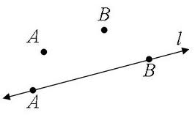
Lines
Lines are named by picking two points on the lines.
Lines can also be called by its designated cursive letter.
AB or l
Notes:
to designate a line, the symbol above the name MUST have arrows

Slide 4
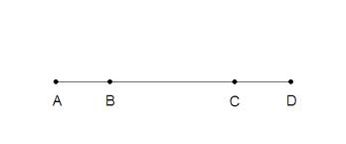
Line segments
Lines segments are named by its endpoints.
AB , AC ,
AD , BC,
BD, CD
Notes:
to designate a line segment, the symbol above the name WILL NOT have arrows

Slide 5
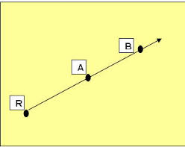
Ray
Rays are named using two points on the ray;
*the first point in the name must be the endpoint.
RA or RB
Notes:
the picture cannot be named ray AB because A is not an endpoint

Slide 6
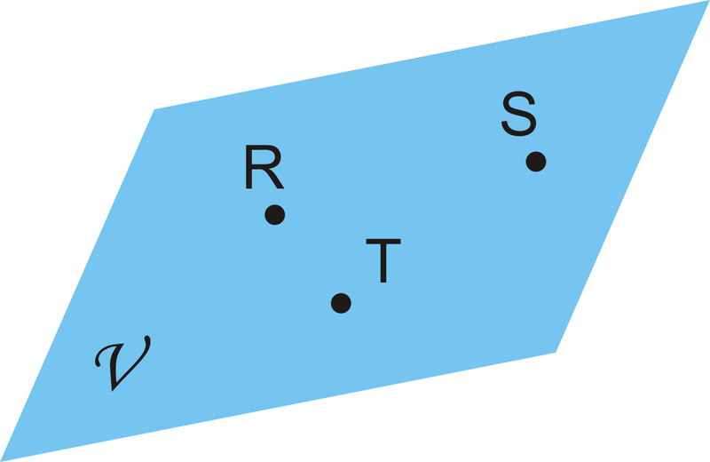
Planes
Planes are named by three points on the plane; planes can also be named by its designated cursive letter.
Plane RST
or
Plane V

Slide 7
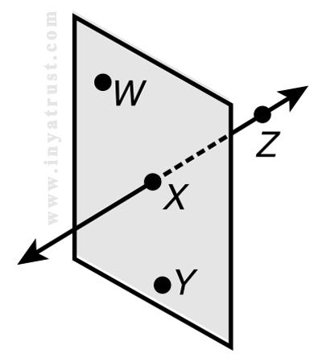
Coplanar and collinear points
Collinear points: points on the same line.
Coplanar points: points on the same plane.

Slide 8
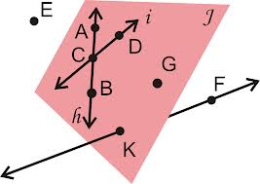
name lines, segments, rays and planes
What points are non-coplanar?
Notes:
Lines: i, h, AB, AC, CD, FK
Segments: AC, AB, BC, CD, FK
Rays: CD, DC, CA, CB, BC, BA, AC, AB, FK, KF
Planes: J, ACG, ABG, ABD, ACB, AKG...

