Slide 1
1.2 Segments and Congruence
Mrs. Vazquez
Class

Slide 2
G.CO.1
Essential Question:
What are congruent segments?
Objective:
Students will be able to use segment postulates to identify congruent segments.

Slide 3
Ruler postulate
The distance between two points is the absolute value of the difference of their coordinates.
distance of AB = | B - A |
A = 3in
B = 6in
AB = |6 - 3|
AB = 3in

Slide 4
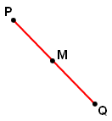
Segment Addition postulate
If M is between P and Q,
then PM MQ PQ.
If PM MQ PQ, then M is between P and Q.

Slide 5
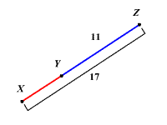
Apply Segment addition postulate
If Y is between
X & Z, then
XY + YZ = XZ.
If XZ = 17 &
YZ = 11, then
XY + 11 = 17.
Subtraction Property of Equality
-11 -11
XY = 6 units

Slide 6
Apply Segment addition postulate
If OQ = 3x - 16;
QP = 4x - 8;
OP = 60.
Find the value of x.
Then find OQ and QP.
OQ + QP = OP
(3x - 16) + (4x - 8) = 60
7x - 24 = 60
7x = 84
x = 12
OQ = 20 QP = 40

Slide 7
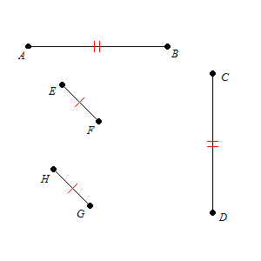
congruent (≅) segments
line segments that have the same length
* ≅ segments are marked with corresponding ticks
EF ≅ HG
AB ≅ CD

Slide 8
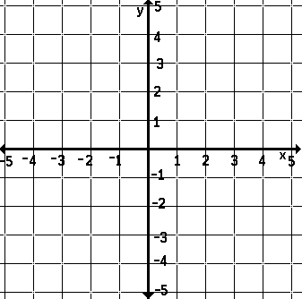
Compare segments for congruence
plot A(-2,4);
B (3,4);
C (0,2);
D (0, -2).
Determine whether AB & CD are ≅
A
B
AB = 5 units
CD = 4 units
C
D
AB ≆ CD

