Slide 1
1.3 Use Midpoint and Distance Formulas
Mrs. vazquez
Geometry

Slide 2
G.GPE.7
Essential Question:
How do you find the distance and the midpoint between two points on a coordinate plane?
Objective:
Students will be able to find lengths of segments on a coordinate plane.

Slide 3
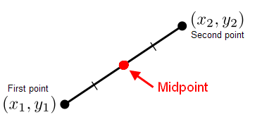
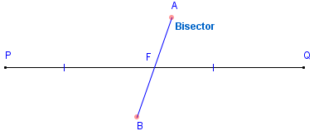
Vocab
midpoint: point that divides a segment into two ≅segments
segment bisector: a point, ray, line, line segment, or plane
that intersects the
segment at its
midpoint

Slide 4
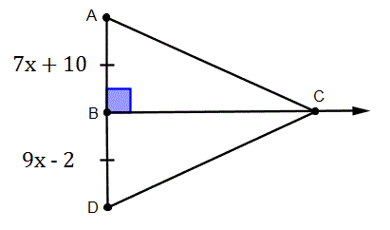
Practice
7x + 10 = 9x - 2
-7x +2 -7x +2
What is the length of BD?
12 = 2x
x = 6
BD = 9x - 2
BD = 9(6) - 2
BD = 52 units
Notes:
AB is congruent to BD. Therefore AB = BD.

Slide 5
Midpoint Formula
If A(x₁,y₁) & B(x₂,y₂) are points
on a coordinate plane, then
the midpoint M is
x₁+x₂ , y₁+y₂
2 2
Notes:
Think of midpoint as the average for the x-coordinate & the y-coordinates in an ordered pair.

Slide 6
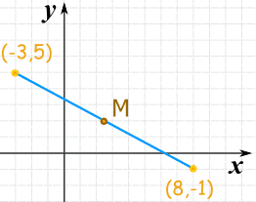
Use the Midpoint formula to find the coordinates of M.
x₁+ x₂ , y₁ + y₂
2 2
(-3)+(8) , (5)+(-1)
2 2
5 , 4
2 2
5 ,
2
2

Slide 7
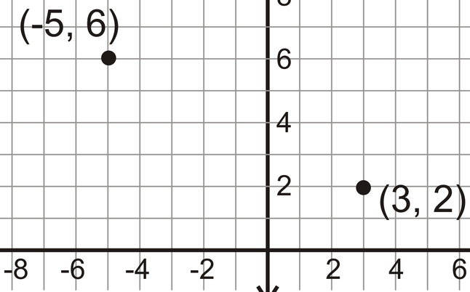
Distance Formula
If A(x₁,y₁) and B(x₂,y₂)
are points on a
coordinate plane,
then the distance
between A & B is
√(x₂- x₁)² + (y₂- y₁)²
√(-5 - 3)² + (6 - 2)²
=√(-8)² + (4)²
=√64 + 16
= √ 80
= 4√5

Slide 8
Pythagorean Theorem
Notes:
Pythagorean Theorem & the Distance Formula are related.
Let a = the distance between the x’s (x₂ - x₁)
Let b = the distance between the y’s (y₂ - y₁)
Let c be the distance of the hypotenuse.
Since a² + b² = c², √(a² + b²) = c.

Slide 9
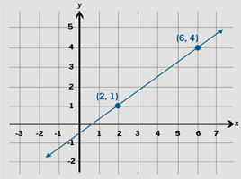
Apply pythagorean theorem
Notes:
height (a) = 3 units
width (b) = 4 units
3² + 4² = c²
9 + 16 = c²
25 = c²
5 = c

