Slide 1
1.4 Measure and Classify Angles
Mrs. Vazquez
Geometry

Slide 2
G.CO.1
Essential Question:
How do you identify whether an angle is acute, right, obtuse, or straight?
Objective:
Students will be able to name, measure, and classify angles.

Slide 3
parts of an angle

Slide 4
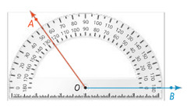
Protractor Postulate
The m∡AOB is equal to the absolute value of the difference between the real numbers for OA and OB.
m∡AOB = |55º - 180º|
m∡AOB = |-125º|
m∡AOB = 125º

Slide 5
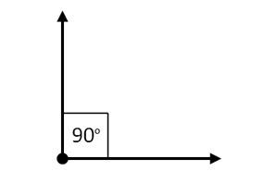
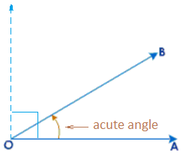
Classify Angles
Right angle (∟).
The m ∟= 90º
Acute ∡.
The m of an acute ∡ < 90º.

Slide 6
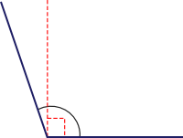
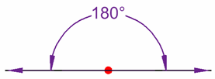
Classify Angles
Obtuse ∡.
The m of an obtuse ∡> 90º.
Straight ∡.
The m of a straight∡= 180º.

Slide 7
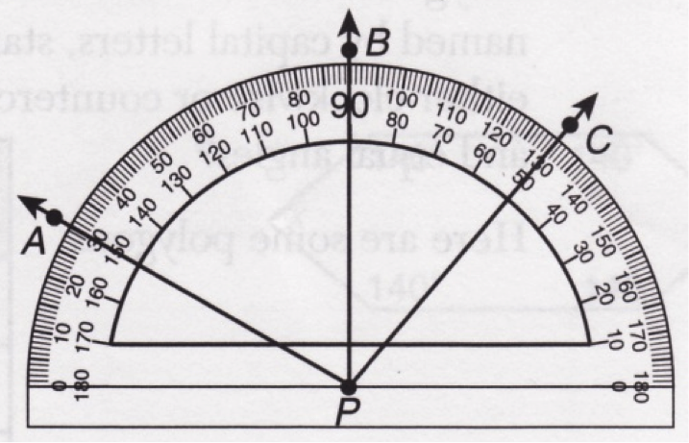
find the measure of an angle & classify the angle
m∡APB
m∡APC
m∡BPC
= 60º
= 100º
= 40º

Slide 8
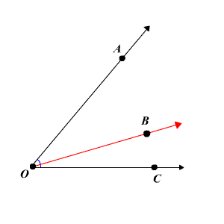
Angle Addition postulate
If B is in the interior of
∡AOC, then the m∡AOC is equal to the sum of
m∡AOB and m∡BOC.
m∡AOC = m∡AOB + m∡BOC

Slide 9
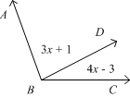
Apply the angle addition postulate
m∡ABC = 110º
Find the m∡DBC.
m∡ABC = m∡ABD + m∡DBC
110º = (3x + 1) + (4x - 3)
110º = 7x - 2
112º = 7x
16º = x
m∡DBC = 4x-3
m∡DBC = 4(16) - 3 = 61º

Slide 10
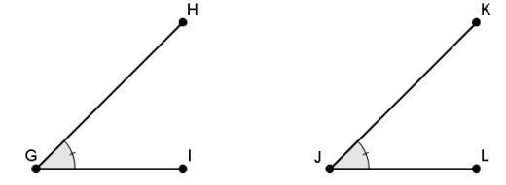
≅ ∡s
Two ∡s are ≅ if they have the same measure.
m∡HGI = m∡KJL, therefore
∡HGI ≅ ∡KJL

