Slide 1
1.5 Describe Angle Pair Relationships
Mrs. vAZQUEZ
Geometry

Slide 2
G.co.1, g.co.9
Essential Question:
How will I use angle relationships to find their measurements?
Objective:
Students will be able to use special angle relationships to find angle measurements.

Slide 3
What angles are complementary? Supplementary? Adjacent?
Are ∡KGH and ∡LKG adjacent? ∡FGK and ∡FGH?
F
G
41º
131º
H
49º
K
L
Notes:
complementary: ∡s that have a sum of 90º
supplementary: ∡s that have a sum of 180º
adjacent: separate ∡s that share a side (or are next to each other)
∡FGK & ∡GKL are complementary. ∡GKL & ∡KGH are supplementary ∡FGK & ∡KGH are adjacent
∡KGH & LKG are not adjacent ∡FGK & FGH are not adjacent either

Slide 4
Find ∡ measurements
If ∡1 is a complement to ∡2 and m∡1 = 27º, find m∡2.
If ∡3 is a supplement to ∡4 and m∡3 = 48º, find m∡4.
m∡1 + m∡2 = 90º
m∡3 + m∡4 = 180⁰
48º + m∡4 = 180º
27º + m∡2 = 90º
Notes:
m∡2 = 63º
m∡4 = 132º

Slide 5
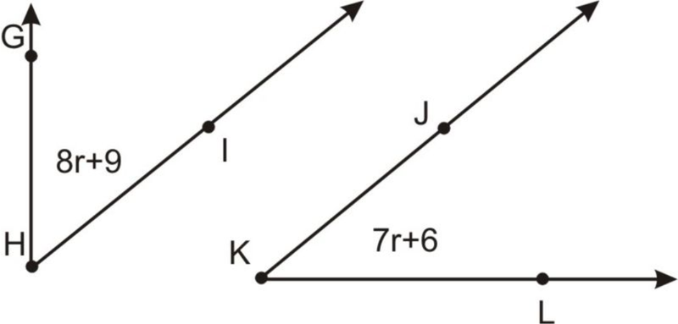
find ∡ measurements
∡GHI is a complement to ∡JKL . Find m∡GHI and m∡JKL.
m∡GHI + m∡JKL = 90º
(8r + 9) + (7r + 6) = 90º
Notes:
r = 5
m∡GHI = 49º
m∡JKL = 41º

Slide 6
Identify Linear Pairs & vertical ∡s
∡__ is a linear pair with ∡__
∡__ and ∡__ are vertical ∡s
If m∡1=2a and m∡2=7a, find m∡1 and m∡2.
2
3
1
5
4
m∡1 + m∡2 = 180º
Notes:
linear pair : two ∡s that form a straight line
vertical ∡s: two ∡s that share a vertex & are opposite each other
a = 20º
m∡1 = 40º
m∡2 = 140º

