Slide 1
10.1 Use Properties of Tangents
Mrs. Vazquez
Geometry

Slide 2
g-co.1.1, g-c.1.2, 2.4
Essential Question:
How can I use a tangent to find a measure of a circle?
Objective:
Students will be able to use tangents to find measures.

Slide 3
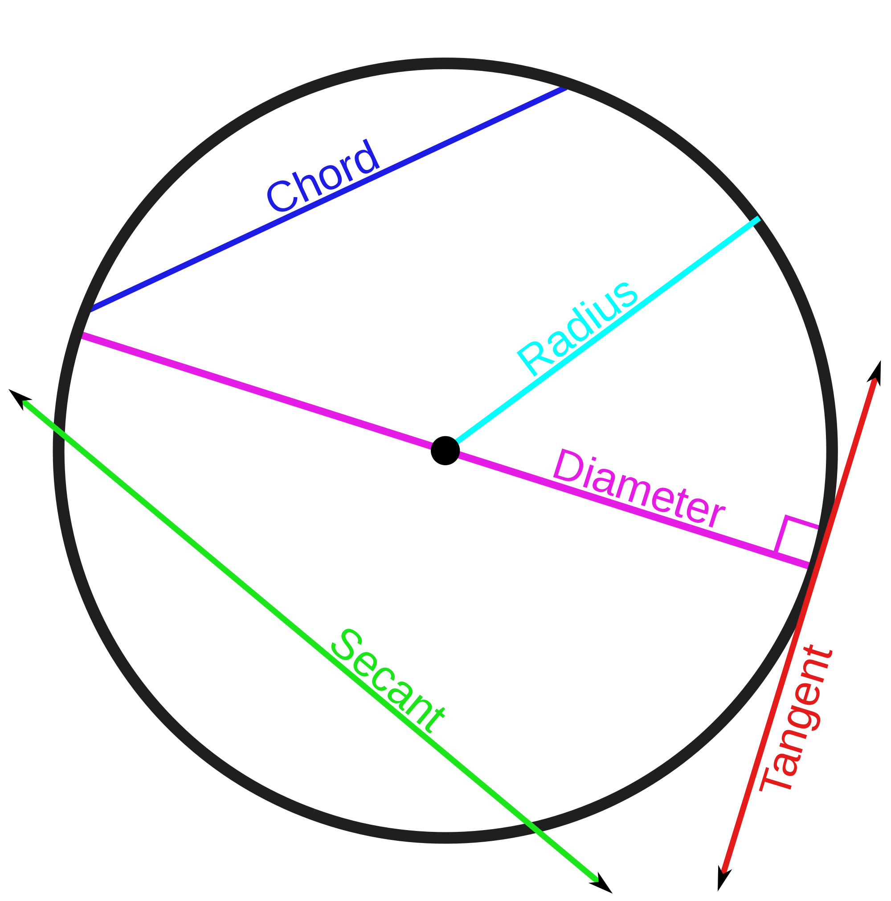
vocab
chord: segment whose endpoints are on a ⊙
secant: line that intersects a ⊙ at two points
tangent: line on a plane of a ⊙ that intersects the ⊙ at exactly one point

Slide 4
concentric ⊙s
coplanar circles that have a common center

Slide 5
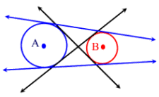
common tangents
a line, ray, or segment that is tangent to two coplanar circles

Slide 6
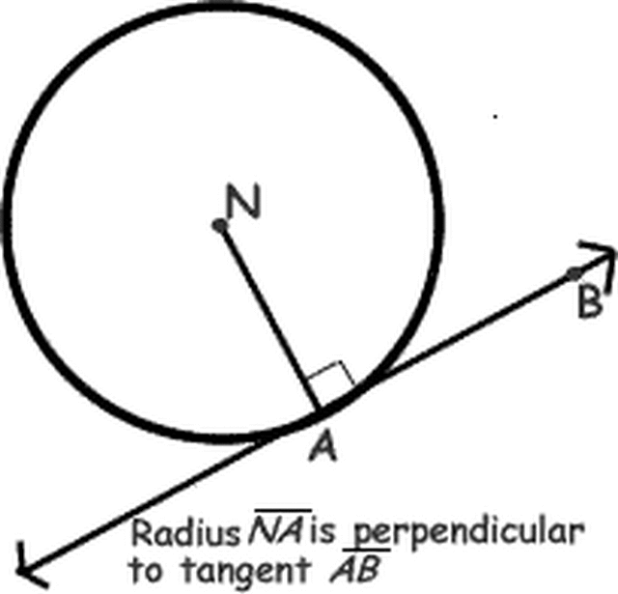
thm 10.1
In a plane, a line is tangent to a circle iff the line is ⊥ to a radius of the circle at its endpoint on the circle.

Slide 7
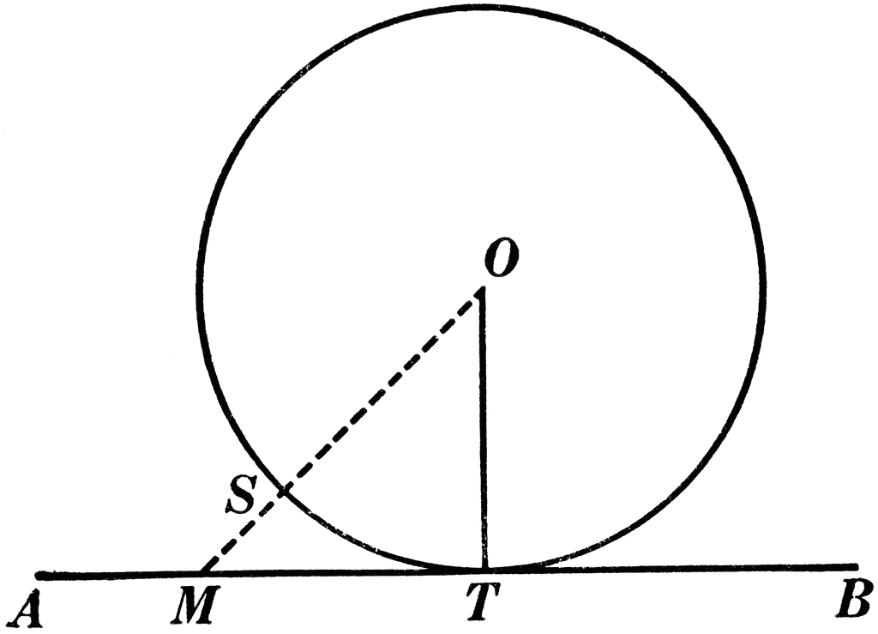
Find the radius
AT is tangent to ⊙O at T.
MT = 24units
MS = 18units

Slide 8
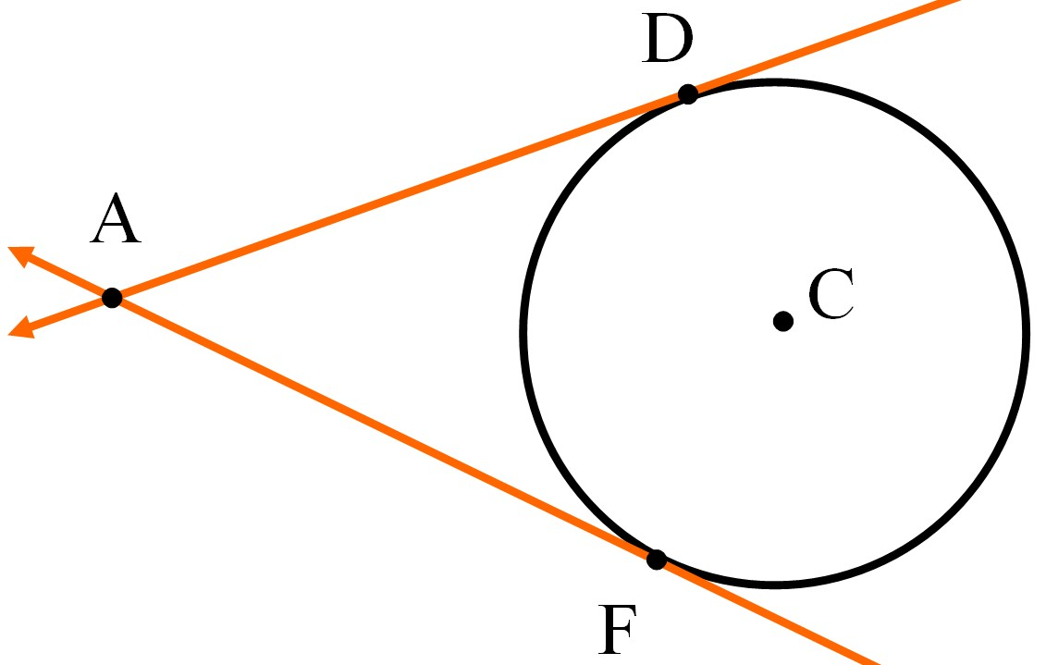
thm 10.2
Tangent segments from a common external point are ≅.

Slide 9
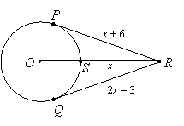
solve for x

