Slide 1
10.2 Find ⁀ Measures
Mrs. vazquez
Geometry

Slide 2
g-co.1.1
Essential Question:
How can I use m∡ to find arc measures?
Objective:
Students will be able to use m∡ to find arc measures.

Slide 3
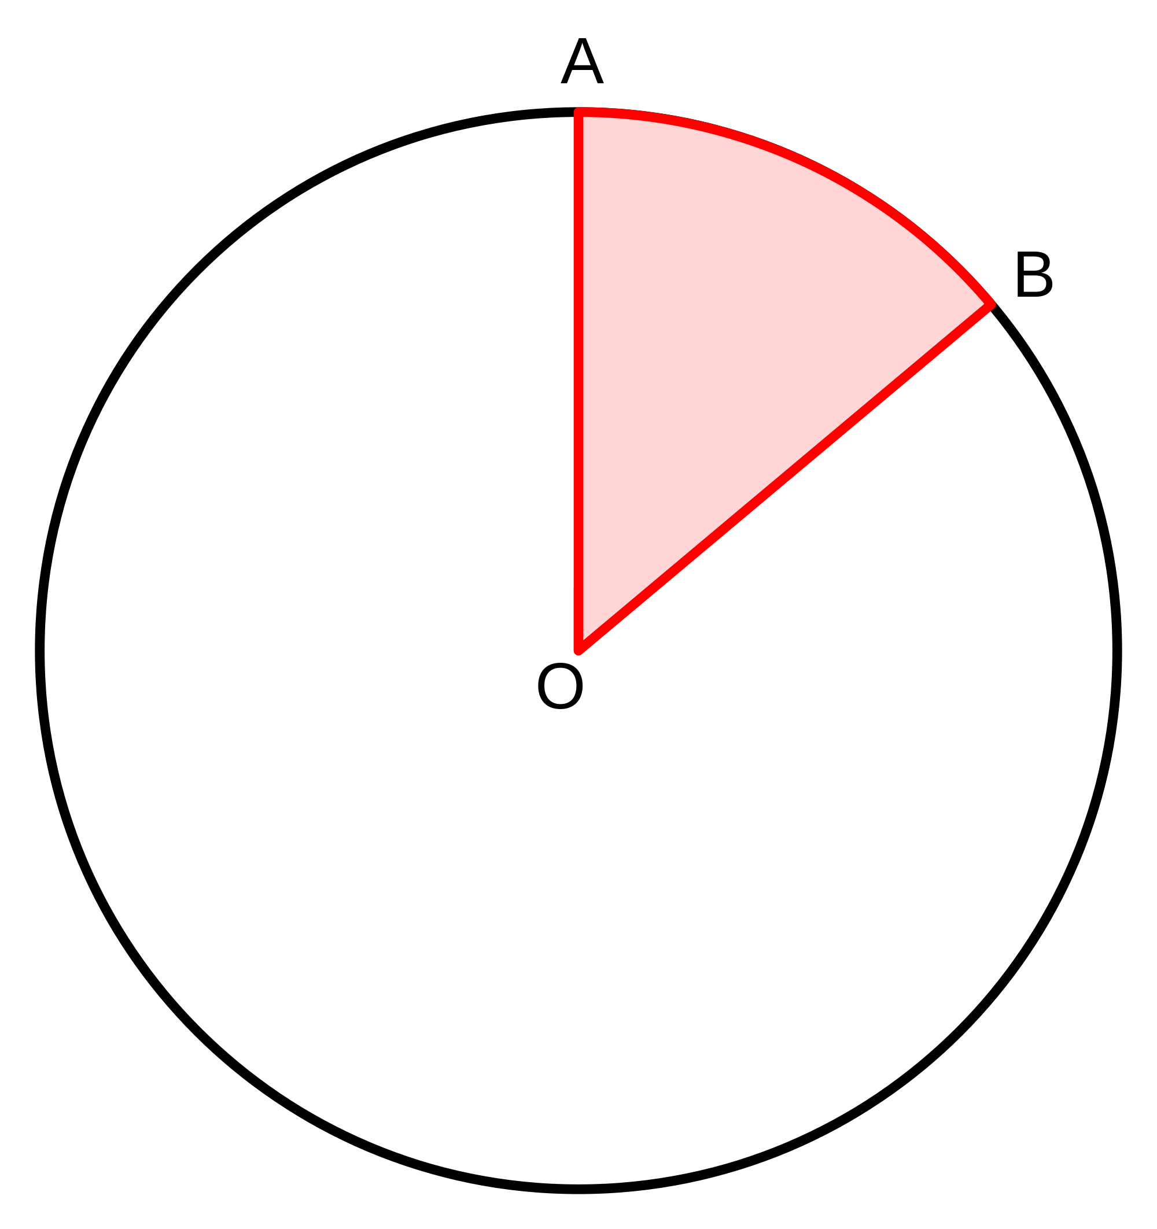
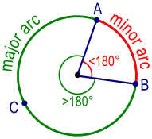
vocab
central ∡: an ∡ whose vertex is in the center of the ⊙
minor ⁀: when the central ∡ is <180º
major ⁀: when the central ∡ is >180º

Slide 4
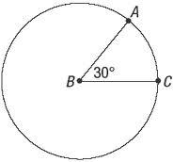
⁀ measures
m of the minor ⁀ = m of central ∡
m of major ⁀ = 360º - m of minor ⁀

Slide 5
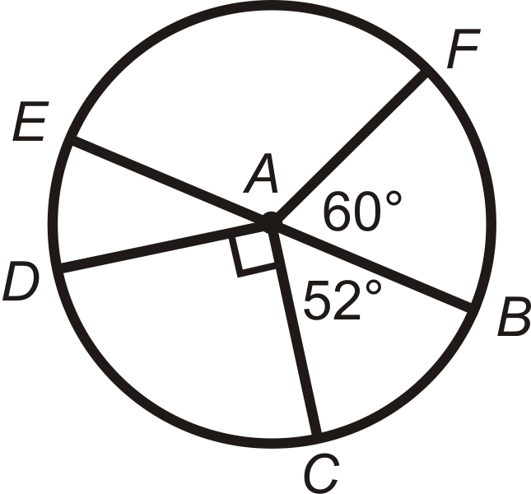
⁀ addition postulate
The m of an ⁀ formed by two adjacent ⁀s is the sum of the measures of the two ⁀s.

Slide 6
≅ ⊙s & ≅ ⁀s
Two ⊙s are ≅ if they have the same radius.
Two ⁀s are ≅ if they have the same measure & they are⁀s of the same ⊙ -or- of ≅ ⊙s.

Slide 7
radians
⁀ length in terms of 𝛑
Convert 60º to radians.

