Slide 1
10.3 Apply Properties of Chords
Mrs. vazquez
Geometry

Slide 2
g-co.4.12, g-c.1.2-3
Essential Question:
How can I use use the relationship between arcs and chords in a ⊙?
Objective:
Students will be able to use the relationship between arcs and chords in a ⊙.

Slide 3
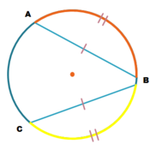
thm 10.3
In a same ⊙, or in ≅ ⊙s, two minor ⁀s are ≅ iff their corresponding chords are ≅.

Slide 4
thm 10.4
If one chord is a ⊥ bisector of another chord, then the first chord is a diameter.

Slide 5
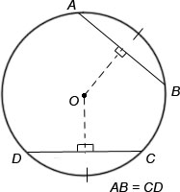
thm 10.6
In the same ⊙, or in ≅ ⊙s, two chords are ≅ iff they are equidistant from the center.

Slide 6
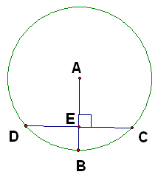
⁀DB is 9xº
⁀CB is (80-x)º
Find ⁀CB.
Find ⁀CD.

Slide 7
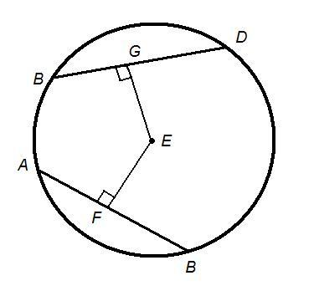
GE is 2x units.
FE is 5x - 9 units.
AB is 32 units.
Find BD.
Find AF.
Find the radius of ⊙E.

