Slide 1
10.4 Use Inscribed ∡s and Polygons
Mrs. vazquez
Geometry

Slide 2
g-c.1.2-4, 2.5
Essential Question:
How can I use inscribed ∡s of ⊙s?
Objective:
Students will be able to use inscribed ∡s of ⊙s.

Slide 3
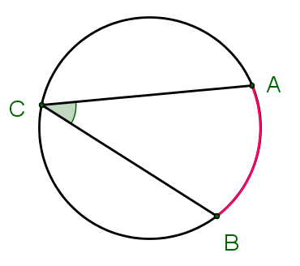
vocab
inscribed ∡: an ∡ whose vertex is on a ⊙ & whose sides contain chords of the ⊙
intercepted ⁀: the⁀ that lies in the interior of an inscribed ∡

Slide 4
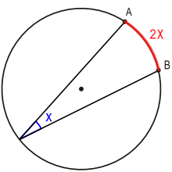
measure of an inscribed ∡ thm
The measure of an inscribed ∡ is ½ the measure of its intercepted⁀

Slide 5
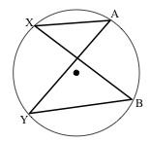
thm 10.8
If two inscribed ∡s of a ⊙ intercept the same ⁀, then the ∡s are ≅.

Slide 6
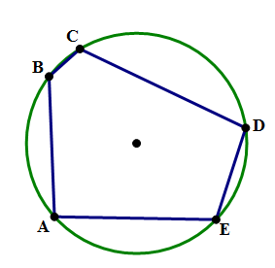
vocab
inscribed polygon: a polygon whose vertices lie on a ⊙
circumscribed ⊙: a ⊙ that contains the vertices of an inscribed polygon

Slide 7
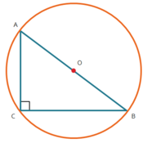
thm 10.9 + converse
If a ⊿ is inscribed in a ⊙, then the hypotenuse is a diameter of the ⊙.

Slide 8
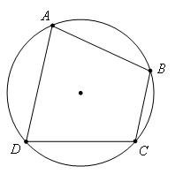
thm 10.10
A quadrilateral can be inscribed in a ⊙ iff its opposite ∡s are supplementary.

Slide 9
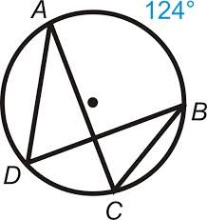
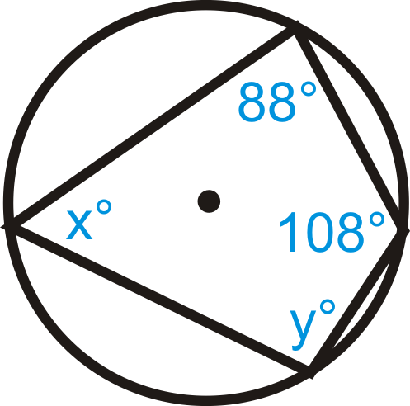
Solve for ∡ACB & ∡ADB
Solve for x & y below.

