Slide 1
10.5 Apply Other ∡ Relationship in ⊙s
Mrs. Vazquez
Geometry

Slide 2
g-c.1.2, 2.5
Essential Question:
How can I find measures of ∡s inside/outside the ⊙?
Objective:
Students will be able to find measures of ∡s inside/outside the ⊙.

Slide 3
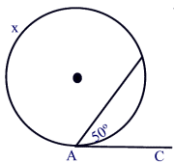
thm 10.11
If a tangent & a chord intersect at a point on a ⊙, then the measure of each ∡ formed is ½ the measure of its intercepted ⁀.

Slide 4
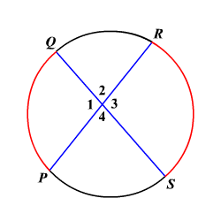
∡s inside the ⊙ thm
If two chords intersect inside a ⊙, then the measure of each ∡ is ½ the sum of the measures of the ⁀ intercepted by the ∡ & its vertical ∡.

Slide 5
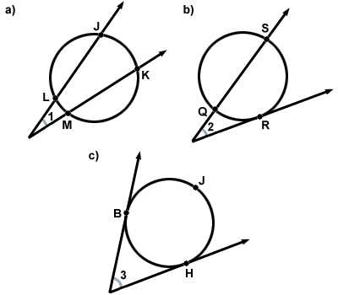
∡s outside the ⊙ thm
If a tangent & a secant/ two tangents/ or two secants intersect outside a ⊙, then the measure of the ∡ formed is ½ the difference of the measures of the intercepted arcs.

Slide 6
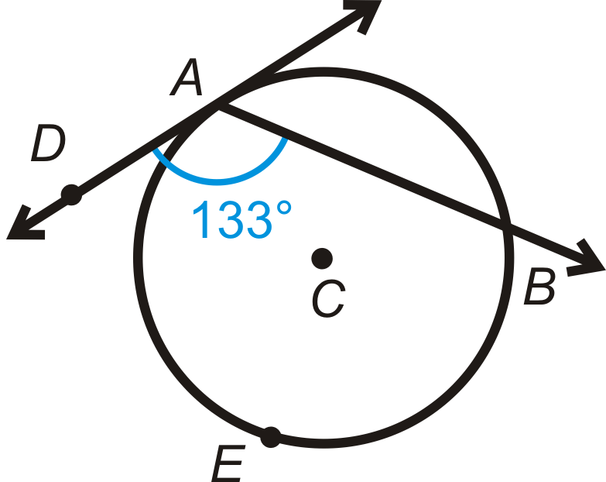
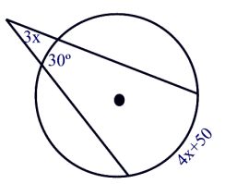

Slide 7
