Slide 1
10.6 Find Segment Lengths in ⊙s
Mrs. Vazquez
Geometry

Slide 2
g-c.1.2
Essential Question:
How can I find lengths of segments with ⊙s?
Objective:
Students will be able to find segment lengths in ⊙s.

Slide 3
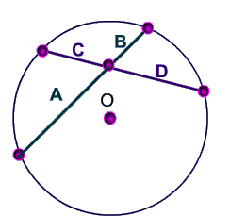
Segments of chords thm
If two chords intersect in the interior of a ⊙, then the product of the lengths of the segments of one chord is equal to the product of the lengths of segments of the other chord.
A∙B = C∙D

Slide 4
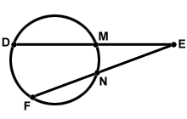
Segments of secants thm
If two secants share the same endpoint outside a ⊙, then the product of the lengths of one secant segment & its external segment equals the product of the lengths of the other secant segment & its external segment.
DE∙ME = FE∙NE

Slide 5
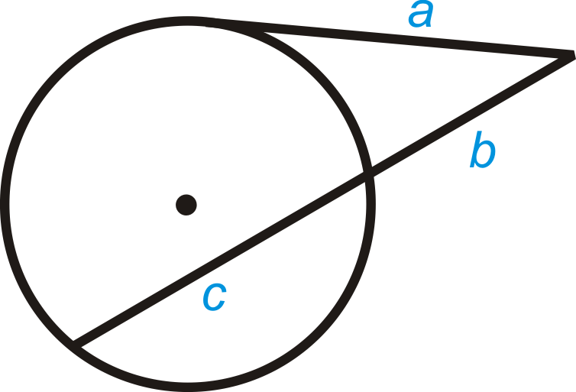
segments of secants & tangents thm
If a secant & a tangent share an endpoint outside a ⊙, then the product of the lengths of the secant segment & its external segment equals the square of the length of the tangent segment.
(c+b)∙b = a²

Slide 6
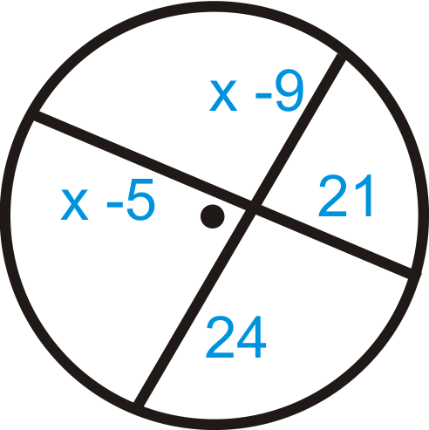
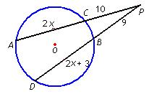

Slide 7
