Slide 1
10.7 Write and Graph Equations of ⊙s
Mrs. Vazquez
Geometry

Slide 2
g-gpe.1.1
Essential Question:
How can I find equations of ⊙s on a coordinate plane?
Objective:
Students will be able to write equations of circles ⊙s on a coordinate plane and graph them.

Slide 3
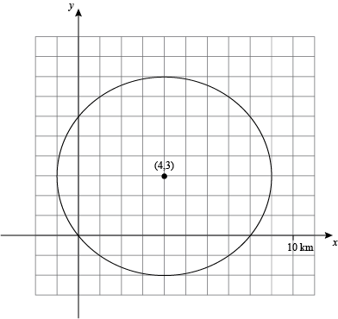
Standard equation of a ⊙
center: (h,k)
radius: r
(x - h)² + (y - k)² = r²

Slide 4
Write an equation
The point (3,4) is on the circle whose center is (1,4).
Find the radius using the distance formula
Substitute ordered pair of the center & radius into the equation of a ⊙.

Slide 5
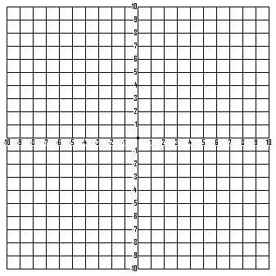
graph
(x - 4)² + (y + 3)² = 16

