Slide 1
3.1 Identify Pairs of Lines and Angles
Mrs. vazquez
Geometry

Slide 2
g-co.1.1, 3.9
Essential Question:
What relationship would certain angles have based on their properties?
Objective:
Students will be able to identify angle pairs formed by three intersecting lines.

Slide 3
Definitions
|| lines: two coplanar lines that do not intersect
Skew lines: noncoplanar lines that do not intersect

Slide 4
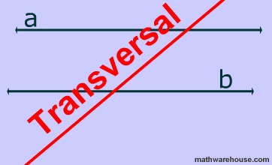
Transversal
a line that intersects two or more coplanar lines at different points

Slide 5
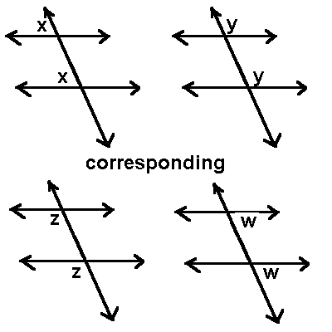
corresponding ∡s
∡s that have corresponding (matching) positions

Slide 6
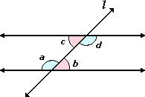
alternate interior ∡s
two ∡s that lie between two lines and are on opposite sides of the transversal

Slide 7
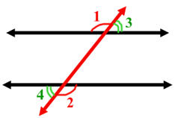
alternate exterior ∡s
two ∡s that lie outside two lines and are on opposite sides of the transversal

Slide 8
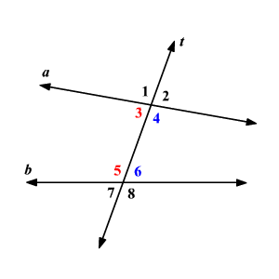
consecutive interior ∡s
two ∡s that lie between two lines and are on the same side of the transversal

Slide 9
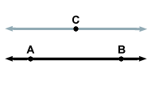
Postulates
13. || Postulate
If there is a line and a point not on the line, then there is exactly one line through the point || to the given line.
14. ⊥ Postulate
If there is a line and a point not on the line, then there is exactly one line through the point ⊥ to the given line.

