Slide 1
3.2 Use || Lines and Transversals
Mrs. Vazquez
Geometry

Slide 2
g-CO.3.9
Essential Question:
How do I apply my knowledge of parallel lines and transversals?
Objective:
Students will be able to use angles formed by parallel lines and transversals.

Slide 3
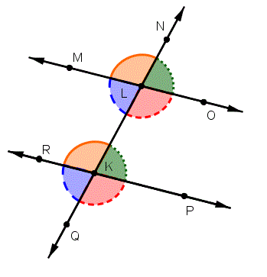
corresponding ∡s postulate
If two || lines are cut by a transversal, then the two pairs of corresponding ∡s are ≅.

Slide 4
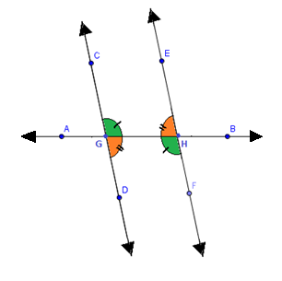
Alt. Int. ∡s theorem
If two || lines are cut by a transversal, then the pairs of alternate interior ∡s are ≅.

Slide 5
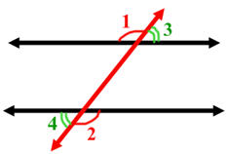
Alt. ext. ∡s theorem
If two || lines are cut by a transversal, then the pairs of alternate exterior ∡s are ≅.

Slide 6
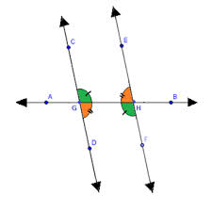
consecutive interior ∡s theorem
If two || lines are cut by a transversal, then the pairs of consecutive interior ∡s are supplementary.

Slide 7
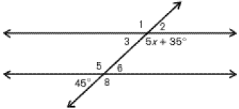
Solve for x
(5x + 35) is a consecutive interior pair with ∡6
=45º
(vertical ∡s)
(5x + 35)º + 45º = 180º
Notes:
(5x + 35) + 45 = 180º
5x + 80 = 180º
5x = 100º
x = 20

