Slide 1
3.3 Prove Lines are ||
Mrs. vazquez
Geometry

Slide 2
g-CO.3.9
Essential Question:
How do you know the lines are parallel?
Objective:
Students will be able to use angle relationships to prove that lines are parallel.

Slide 3
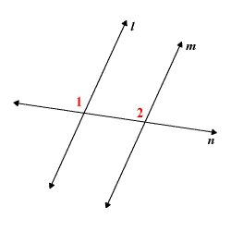
Corresponding ∡s postulate
Postulate 15:
If two || lines are cut by a transversal, then the two pairs of corresponding ∡s are ≅.
Postulate 16:
(converse of Postulate 15)

Slide 4
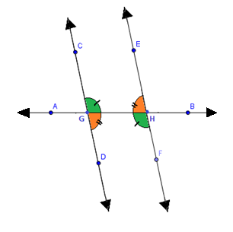
Alternate interior angles
Theorem 3.1
If two || lines are cut by a transversal, then the pairs of alternate interior ∡s are ≅.
Theorem 3.4
(converse of Theorem 3.4)

Slide 5
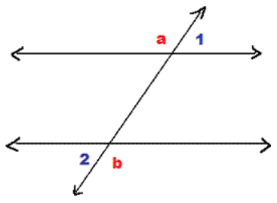
Alternate exterior angles
Theorem 3.2
If two || lines are cut by a transversal, then the pairs of alternate exterior ∡s are ≅.
Theorem 3.5
(converse of Theorem 3.2)

Slide 6
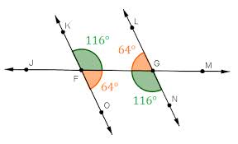
Consecutive interior angles
Theorem 3.3
If two || lines are cut by a transversal, then the pairs of consecutive interior ∡s are supplementary.
Theorem 3.6
(converse of Theorem 3.3)
Why is this picture similar to the Alternate Interior ∡s picture?

Slide 7
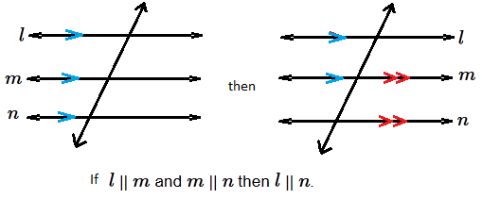
Transitive Property
of || Lines
Theorem 3.7
If two lines are || to the same line, then they are || to each other.

