Slide 1
3.4 Find and Use Slopes of Lines
Mrs. vazquez
Geometry

Slide 2
G-GPE.5
Essential Question:
How does slope relate to || and ⊥ lines?
Objective:
Students will be able to find and compare slopes of lines.

Slide 3
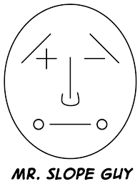
Mr. Slope Guy

Slide 4
Slope formula
y₂ - y₁
x₂ - x₁ = m
m = rise = change in y = ∆y
run change in x ∆x

Slide 5
Postulates
17. Slopes of || Lines
In a coordinate plane, two nonvertical lines are || iff they have the same m.
Any two vertical lines are ||.
18. Slopes of ⊥ Lines
In a coordinate plane, two nonvertical lines are ⊥ iff the product of their slopes is -1.
Horizontal lines are ⊥ to vertical lines.

Slide 6
Which lines are ||?
line k has points on (-2,4), (-3,0)
line n has points on (4,5), (3,1)
line p has points on (6,3), (5, -2)
m = 4
Find the m for each line to determine if any are ||.
m = 4
m = 5

Slide 7
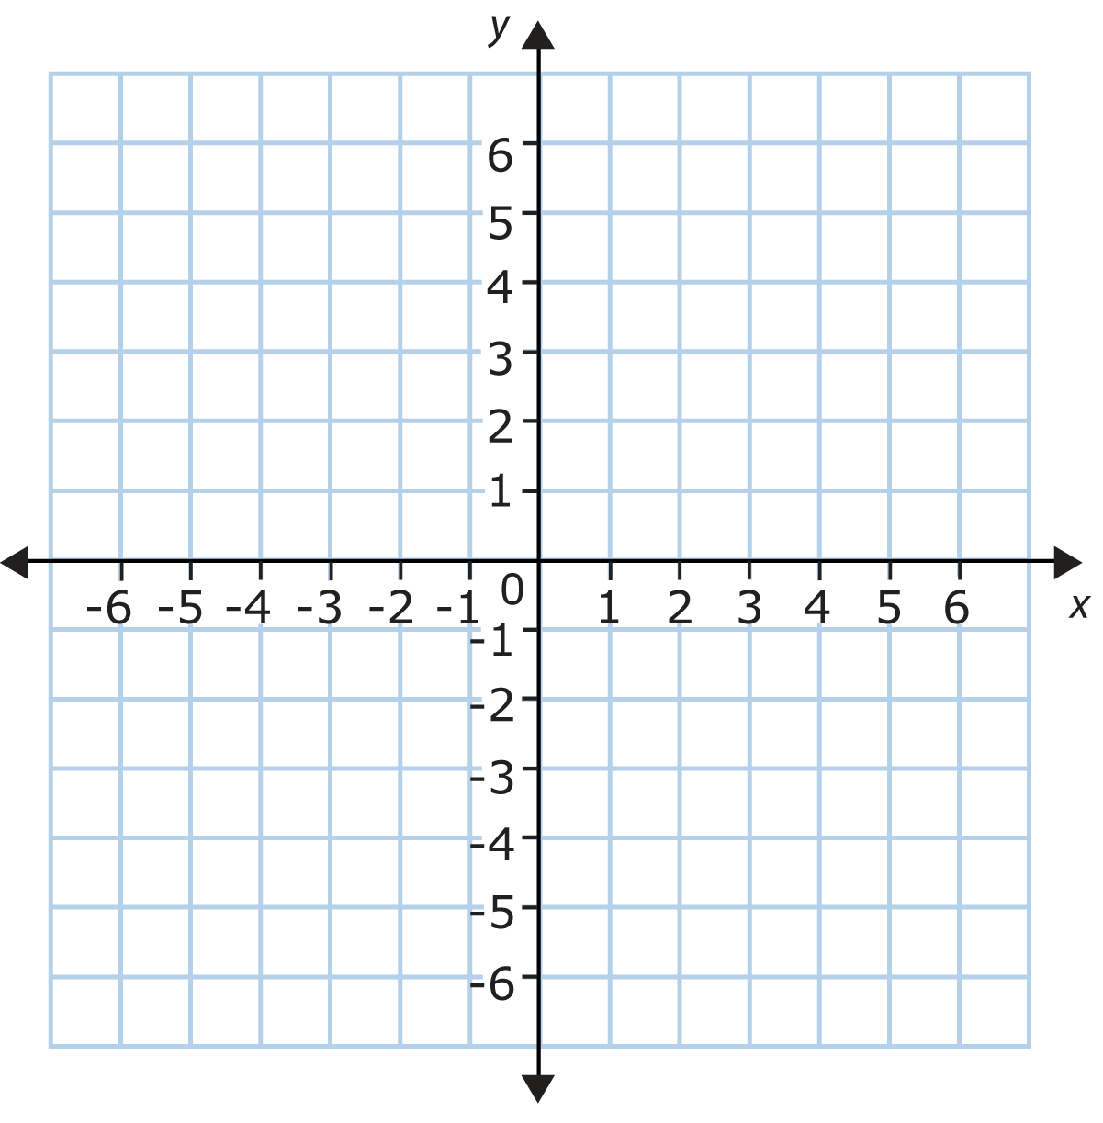
⊥ lines
line h has points at
(7,6), (5,3), (3,0)
draw a line ⊥ to line h
*⊥ lines have opposite reciprocal m.
First, determine the slope of the green line.
Notes:
m = 3/2
so ⊥m has to be -⅔

