Slide 1
3.5 Write and Graph Equations of Lines
Mrs. vazquez
Geometry

Slide 2
g.gpe.5
Essential Question:
How do I use m to write equations of lines?
Objective:
Students will be able to find equations of lines.

Slide 3
Forms
Slope-Intercept Form
y = mx + b
m = slope
b = y-intercept
Standard Form
Ax + By = C
A & B are both not zero

Slide 4
Reminders
|| lines have the same m
⊥ lines have opposite reciprocal m
Standard Form
Ax + By = C
Slope-Intercept Form
y = mx + b
*values for m and b are required

Slide 5
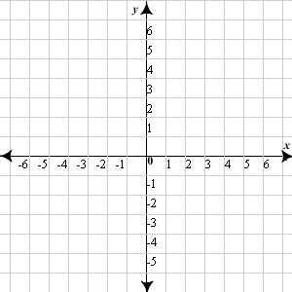
Write a slope-intercept equation
* find two coordinates to calculate slope
* sub an ordered pair for the x and y values
*solve for b
*rewrite in slope-intercept form
Notes:
m = -2
using (1, 2)
2 = (-2)(1) + b
2 = -2 + b
4 = b
y = -2x + 4

Slide 6
|| lines
Write an equation of a line that passes through (1,5) and is || to the line with the equation y = 3x-5.
* use the m of the given equation for the equation of the || line
*sub the ordered pair for x and y values
*solve for b
*rewrite the equation
Notes:
m = 3
5 = (3)(1) + b
5 = 3 + b
2 = b
y = 3x + 2

Slide 7
Graph the equation
2x - 3y = 6
*convert to slope-intercept form to create an equation to graph
Notes:
2x - 3y = 6
-3y = -2x + 6
y = ⅔x - 2

