Slide 1
4.1 Apply ∆ Sum Properties
Mrs. vazquez
Geometry

Slide 2
g-co.3.10
Essential Question:
What measurements do specific ∆s have?
Objective:
Students will be able to classify ∆s and find measures of their ∡s.

Slide 3
Classify ∆s
By side lengths:
Scalene
Isosceles
Equilateral
By m∡:
acute
right
obtuse
equiangular

Slide 4
Classify ∆s
∆ABC has vertices A(0,0), B(3,3), C(-3,3).
Classify it by its sides, then determine if it is a right triangle.

Slide 5
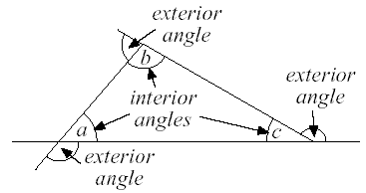
interior/exterior ∡s of ∆s

Slide 6
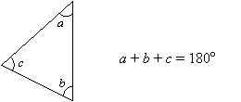
∆ Sum Theorem (4.1)
The sum of the measures of the interior ∡s of a ∆ is 180º.

Slide 7
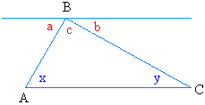
Proof
Given ∆ABC
Given AC || d
Prove: m∡x + m∡y + m∡c = 180º
∡y ≅∡b
∡x ≅∡a
∡a + ∡b + ∡c = 180º
∡x + ∡y + ∡c = 180º
d
alt. int. ∡s
alt. int. ∡s
∡ + post. , straight ∡
substitution prop

Slide 8
definition
corollary to a theorem:
statement that can be proven easily using the theorem

Slide 9
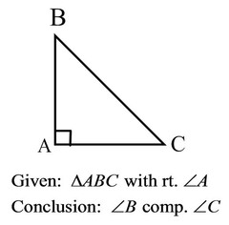
Corollary to the ∆ sum theorem
The acute ∡s of a ⊿ are complementary.

Slide 10
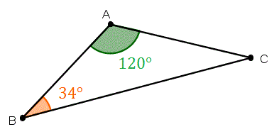
Application
Find m∡C.

Slide 11
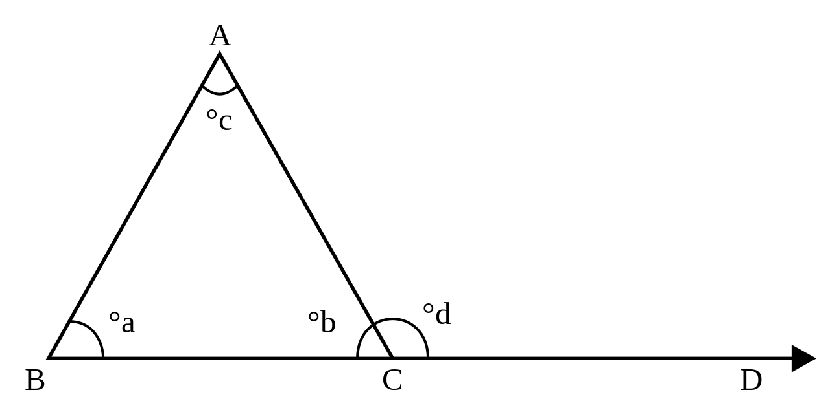
Exterior ∡ Theorem
The measure of an exterior ∡ of a ∆ = the sum of the measures of the two nonadjacent interior ∡s.
m∡BAC + m∡ABC = m∡ACD

Slide 12
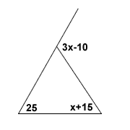
Application
Find x.

