Slide 1
4.2 Apply Congruence and ∆s
Mrs. vazquez
Geometry

Slide 2
g-co.2.7
Essential Question:
Are the figures ≅?
Objective:
Students will be able to identify ≅ ∆ figures?

Slide 3
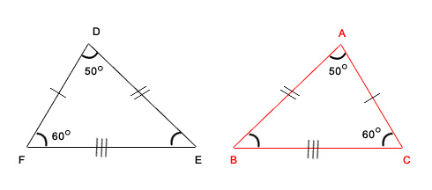
≅ figures
Figures are ≅ if all the parts of one figure are ≅ to the corresponding parts.

Slide 4
≅ parts

Slide 5
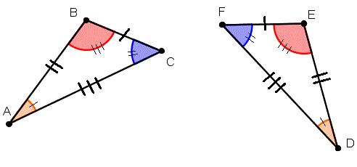
Solve for x
m∡B = 4x + 5
m∡E = 105º
m∡A = 35º

Slide 6
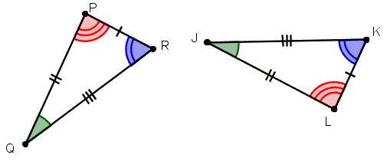
Third ∡s Theorem (4.3)
If two ∡s of one ∆ are ≅ to two ∡s of another ∆, then the third ∡s are also ≅.
If ∡Q ≅∡J,
and ∡P ≅∡L,
then ∡R ≅∡K.

Slide 7
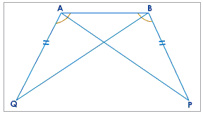
Solve
m∡BAP = 30º
m∡Q = 45º
∡Q ≅ ∡P
Find m∡PBQ

Slide 8
Properties
(4.4) Properties of ≅ ∆s
Reflexive: For any triangle ABC, ∆ABC ≅ ∆ABC.
Symmetric: If ∆ABC ≅ ∆DEF, then ∆DEF ≅ ∆ABC.
Transitive: If ∆ABC ≅ ∆DEF and ∆DEF ≅ ∆JKL,
then ∆ABC ≅ ∆JKL.

