Slide 1
4.3 Relate Transformations
and Congruence
Mrs. vazquez
Geometry

Slide 2
g-co.1.2 , 2.6-7
Essential Question:
How do transformations and congruence relate?
Objective:
Students will be able to use transformations to show congruence.

Slide 3
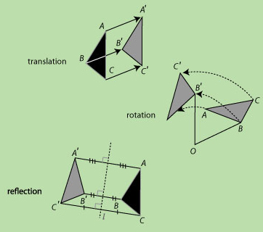
Rigid motions
transformations that preserve length, ∡ measure, and area
*aka “isometry”

Slide 4
Rigid motions
Rigid motions yield ≅ figures because the corresponding parts are ≅.

