Slide 1
4.4 Prove ∆s ≅ by SSS
Mrs. vazquez
Geometry

Slide 2
g.co.8, g.co.10, g.co12
Essential Question:
How can I determine if two ∆s are ≅ given their side measurements?
Objective:
Students will be able to use side lengths to prove ∆s are ≅.

Slide 3
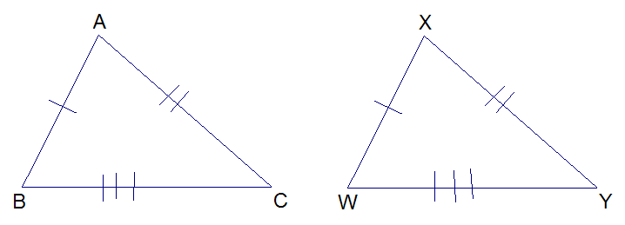
Side-Side-side (SSS) ≅ Postulate
If three sides of one ∆ are ≅ to three sides of a second ∆, then the two ∆s are ≅.

Slide 4
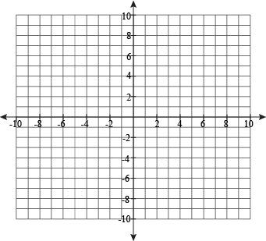
∆JKL has vertices J(-3,-2), K(0,-2), and L(-3,-8). ∆RST has vertices R(10,0), S(10,-3), and T(4,0). Graph the ∆s in that same coordinate plane & show that they are ≅.

Slide 5
Prove ∆EAB ≅ ∆ECD
Given:
AE≅CE,
AB≅CD,
E is the midpoint of BD
A C
B E D

