Slide 1
4.5 Prove ∆s ≅ by SAS and HL
Mrs. vazquez
Geometry

Slide 2
g.co.8, g.co10
Essential Question:
What theorems can I use to prove two ∆s are ≅?
Objective:
Students will be able to use sides and ∡s to prove ≅.

Slide 3
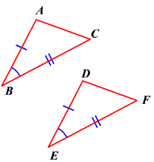
Side-∡-side ≅ postulate (SAS)
If two sides and the included ∡ of one ∆ are ≅ to two sides and the included ∡ of another ∆, then the two ∆s are ≅.

Slide 4
USE SAS to Prove
∆ABC ≅ ∆CDA
Given:
BC ≅ DA
BC || DA
B C
A D

Slide 5
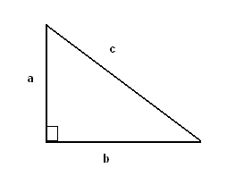
Part of a ⊿
Hypotenuse (c)
Legs (a and b)

Slide 6
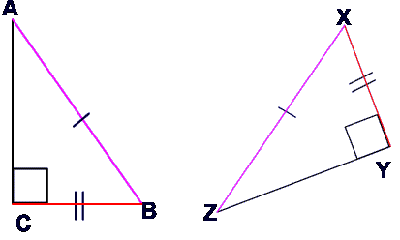
Hypotenuse-Leg ≅ Theorem (HL)
If the hypotenuse and a leg of ⊿ are ≅ to a hypotenuse and a leg of a second ⊿, then the two ∆s are ≅.

Slide 7
Use HL to prove ∆WYZ≅∆XZY
Given:
WY≅XZ
WZ⊥ZY
XY⊥ZY
W X
Z Y

Slide 8
Prove ∆ACB≅∆DBC
Given:
AC≅BD
∡ABC & ∡BCD are ∟
A B
C D

