Slide 1
4.6 Prove ∆s ≅ by ASA and AAS
Mrs. vazquez
Geometry

Slide 2
g.co.8, g.co10
Essential Question:
What theorems can I use to prove two ∆s are ≅?
Objective:
Students will be able to use sides and ∡s to prove ≅.

Slide 3
∡-side-∡ ≅ postulate (ASA)
If two ∡s and the included side of one ∆ are ≅ to two ∡s and the included side of another ∆, then the two ∆s are ≅.

Slide 4
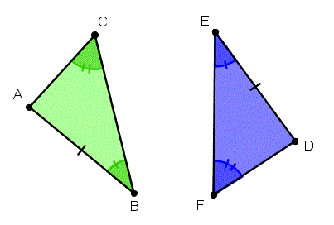
∡-∡-side ≅ postulate (AAS)
If two ∡s and the non-included side of one ∆ are ≅ to two ∡s and the non-included side of another ∆, then the two ∆s are ≅.

Slide 5
Prove ∆XWV≅∆ZWU
Given:
∡X≅∡Z
VW≅UW
Z
X
Y
V
U
W

Slide 6
Prove ∆NMK≅∆LKM
Given:
∡NKM≅∡LMK
∡L≅∡N
L N
K M

