Slide 1
4.8 Use Isosceles and Equilateral ∆s
Mrs. vazquez
Geometry

Slide 2
G-co.3.10
Essential Question:
What theorems apply to isosceles and equilateral ∆s?
Objective:
Students will be able to use theorems the apply to isosceles and equilateral ∆s.

Slide 3
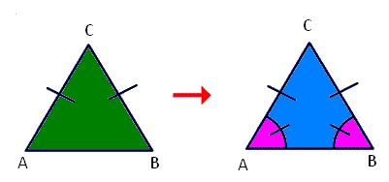
Base ∡s Theorem
If two sides of a ∆ are ≅, then the ∡s opposite them are ≅.

Slide 4
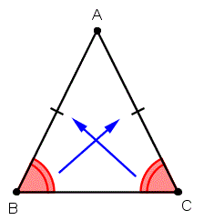
Converse of
Base ∡s Theorem
If two ∡s of a ∆ are ≅, then the sides opposite them are ≅.

Slide 5
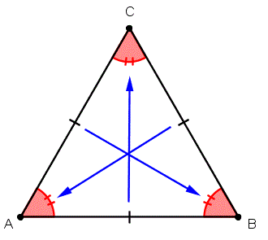
corollary to the base ∡s theorem
If a ∆ is equilateral, then it is equiangular.

Slide 6
If HG ≅ HK, then ∡__≅∡__.
If ∡KHJ≅∡KJH, then __≅__.
H
G K J

