Slide 1
5.1 Midsegment Theorem
and Coordinate Proof
Mrs. vazquez
Geometry

Slide 2
g-Co.3.10 ; g-gpe.2.4
Essential Question:
How can midsegments be proven on a coordinate plane?
Objective:
Students will be able to use properties of midsegments and write coordinate proofs.

Slide 3
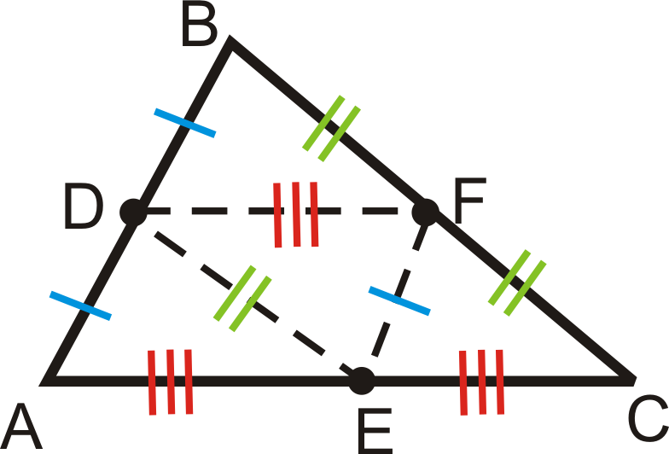
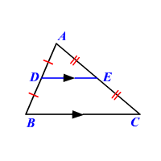
midsegments of ∆s
A segment that connects the midpoints of two sides of the ∆.

Slide 4
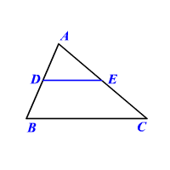
Midsegment Theorem
The segment connecting the midpoints of two sides of a ∆ is ∥ to the third side and is ½ as long as that side.
DE∥BC
DE = ½(BC)

Slide 5
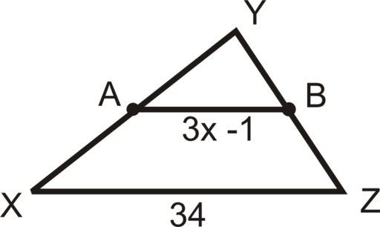
Solve for x
A is the midpoint of XY
B is the midpoint of YZ

Slide 6
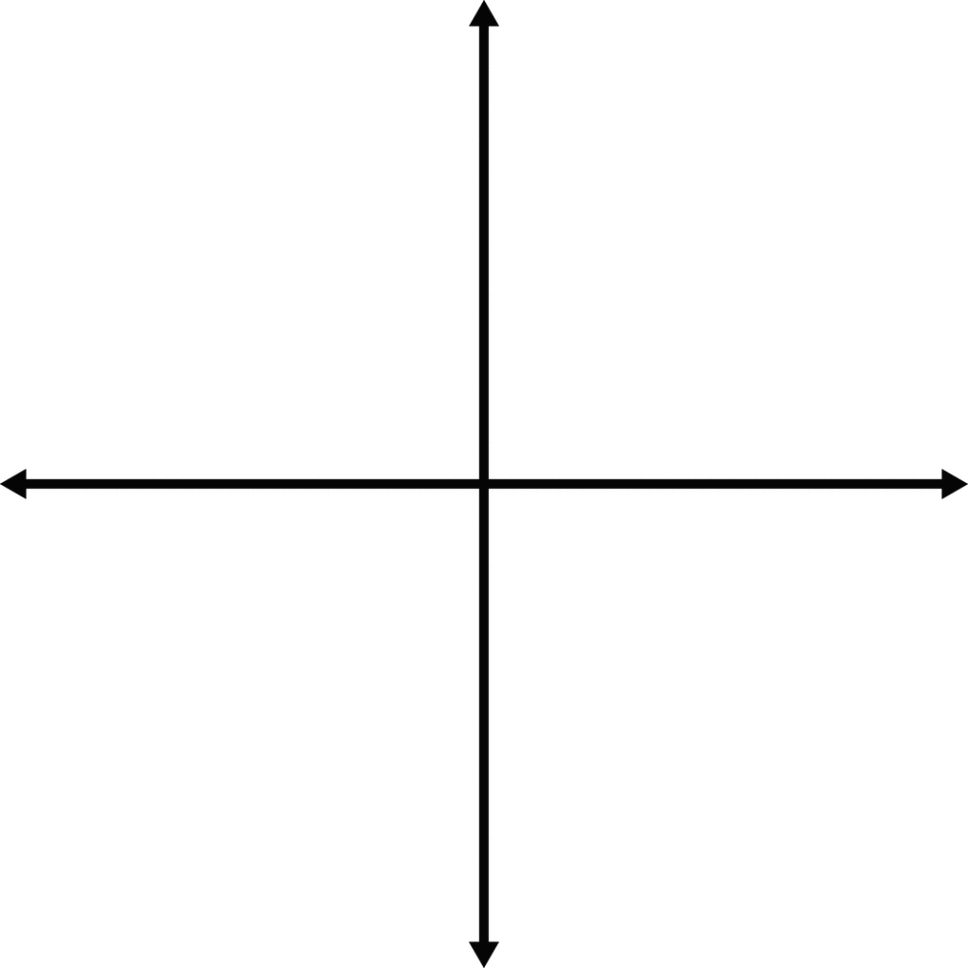
coordinates Geometry
Find the length of the hypotenuse and the coordinates of its midpoint.
(0, a)
(a, 0)

