Slide 1
5.2 Use ⊥ Bisectors
Mrs. vazquez
Geometry

Slide 2
g-Co.3.9, 4.12 ; g-c.1.3
Essential Question:
How can ⊥ bisectors be used in ∆?s?
Objective:
Students will be use ⊥ bisectors to solve problems.

Slide 3
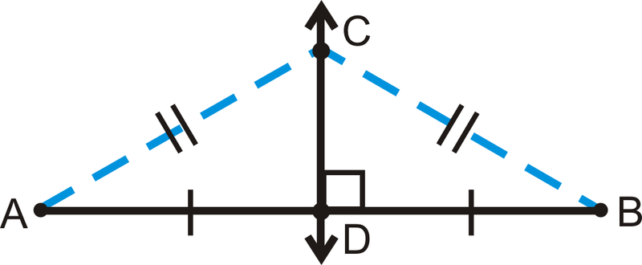
⊥ bisector theorem
In a plane, if a point is on the ⊥ bisector of a segment, then it is equidistant from the endpoints of the segment.
If CD is the ⊥ bisector of AB, then CA=CB.

Slide 4
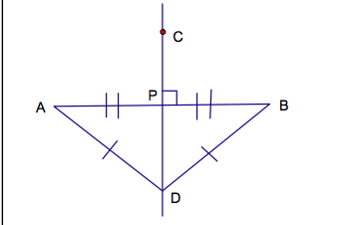
converse of
⊥ bisector theorem
In a plane, if a point is equidistant from the endpoints of a segment, then it is on the ⊥ bisector of a segment.
If DA=BD, then D lies on the ⊥ bisector of AB.

Slide 5
Solve for x
N
∆NLK is isosceles
M J k
L
MN≅ML; MN=8; JK bisects NL
LK = 4x+1; NK = 6x-5
1.Find NK.
2.Why is M on JK?

Slide 6
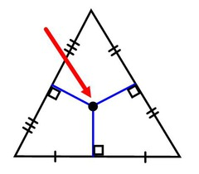
Vocab
Concurrent: when 3+ lines, rays, or segments intersect in the same point

Slide 7
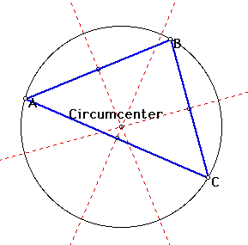
Vocab
Circumcenter: the point of concurrency of the three ⊥ bisectors of a ∆.

Slide 8
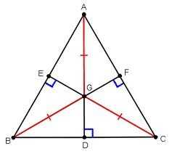
concurrency of ⊥ bisectors of a ∆
The ⊥ bisectors of a ∆ intersect at a point that is equidistant from the vertices of the ∆.
If GE, GF, & GD are ⊥ bisectors, then GA=GB=GC.

Slide 9
real-life Application
Ice cream is sold at three points around the park. Dylan is standing equidistant to all three vendors. Where could he be standing?

