Slide 1
5.3 Use ∡ Bisectors of ∆s
Mrs. Vazquez
Geometry

Slide 2
g-Co.3.10, g-c.1.3
Essential Question:
How can ∡ bisectors be used in ∆?s?
Objective:
Students will be use ∡ bisectors to find distance relationships.

Slide 3
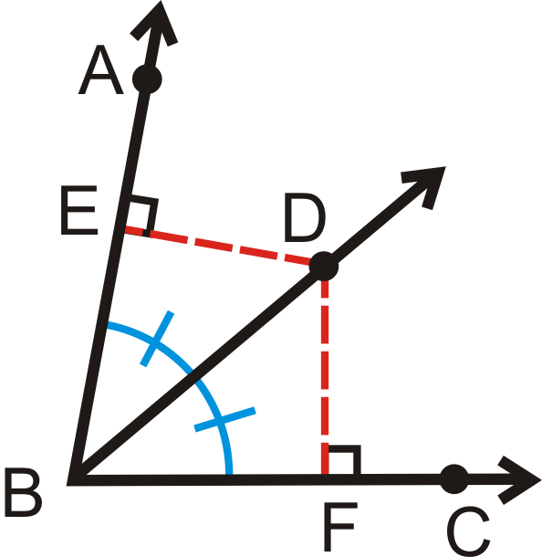
∡ bisector theorem
If a point on the bisector of an ∡, then it is equidistant from the two sides of the ∡.
If BD bisects ∡ABC & ED⊥AB & FD⊥CB, then ED=FD.

Slide 4
Converse of the
∡ bisector theorem
If a point is in the interior of an ∡ and is equidistant from the sides of an ∡, then it lies on the bisector of the ∡.
If ED⊥AB & FD⊥CB & ED=FD, then BD bisects ∡ABC.

Slide 5
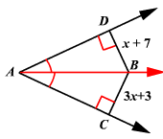
Solve for BD

Slide 6
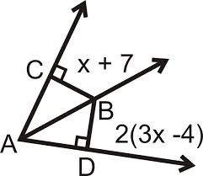
Solve for BD

Slide 7
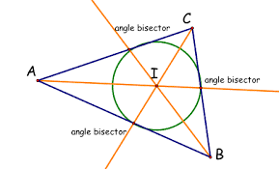
incenter
the point of concurrency of ∡ bisectors

Slide 8
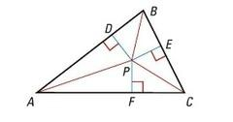
concurrency of ∡ bisectors theorem
The ∡ bisectors of a ∆ intersect at a point that is equidistant from the sides of the ∆.
If AP, BP, & CP are ∡ bisectors of ∆ABC, then PD=PE=PF.

Slide 9
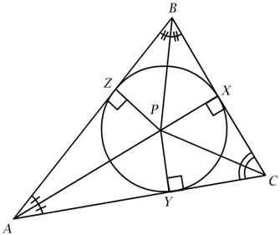
Find YC
ZP = 4x - 1
XP = x + 2
CP = 4x + 1

