Slide 1
5.4 Medians and Altitudes
Mrs. Vazquez
Geometry

Slide 2
g-Co.3.10, 4.12
Essential Question:
What happens when medians and altitudes intersect within a triangle?
Objective:
Students will use medians and altitudes.

Slide 3
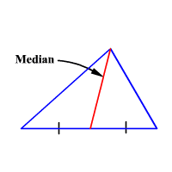
median
a segment from a vertex to the midpoint of the opposite side

Slide 4
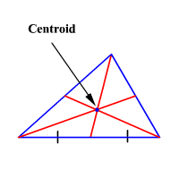
centroid
the point of concurrency of medians

Slide 5
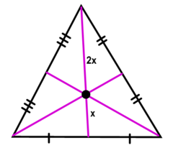
concurrency of
medians of a ∆
The medians of a ∆ intersect at a point that is ⅔ of the distance from each vertex to the midpoint of the opposite side.
The distance from the vertex to the centroid is ⅔ the distance from the vertex to the opposite midoint.

Slide 6
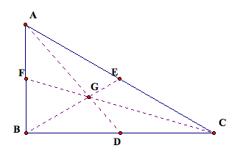
solve for x
BE is a median ∆ABC
BG is 3x + 5
GE is x + 2

Slide 7
solve for x
AD is a median ∆ABC
AD is 27 units
GD is 2x + 1

Slide 8
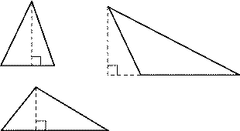
altitude
the ⊥ segment from a vertex to the opposite side or a line that contains the opposite side

Slide 9
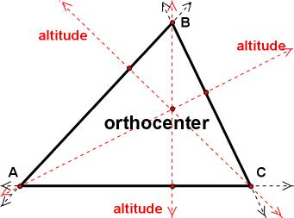
orthocenter
the point at which the lines containing three altitudes of ∆ intersect

Slide 10
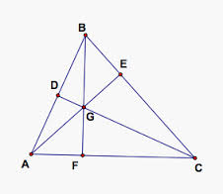
concurrency of altitudes of a ∆
The lines containing the altitudes of a ∆ are concurrent.
If AE, CD, and BF are altitudes of ∆ABC, then G is the orthocenter.

Slide 11
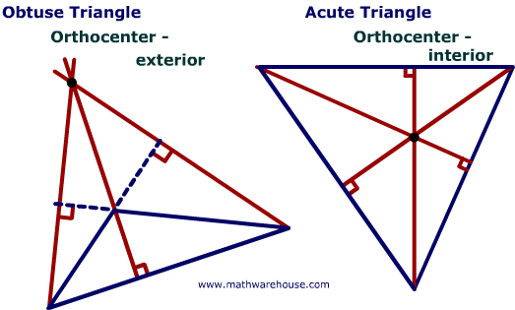
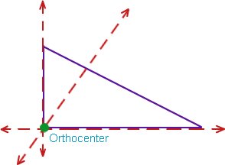
Orthocenter
The orthocenter of a ⊿ is the vertex opposite the hypotenuse.
The orthocenter of an obtuse ∆ is outside of the ∆ itself.
The orthocenter of an acute ∆ is inside the ∆ itself.

