Slide 1
6.2 Relate Transformations and Similarity
MrS. Vazquez
Geometry

Slide 2
g-srt.1.1-2 ; g-c.1.1
Essential Question:
How do dilations preserve similarity of a figure?
Objective:
Students will be able to identify dilations.

Slide 3
definitions
dilations:
transformation that preserves ∡ measures and results in an image with lengths proportional to the preimage lengths
*dilations also have a scale factor
*when 0 < scale factor < 1 the image is a reduction
*when scale factor > 1 the image is an enlargement

Slide 4
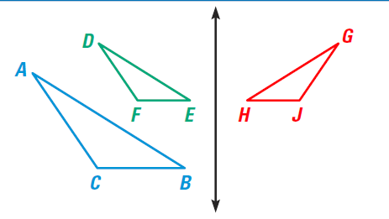
combine dilations
and rigid motions
If a dilation followed by any combination of rigid motions can be used to move one figure onto the other, then the two figures are similar.

Slide 5
find the scale factor to move the blue figure onto the red figure

