Slide 1
6.3 Prove ∆s ~ by AA
Mrs. Vazquez
Geometry

Slide 2
g-srt.1.3
Essential Question:
How do I prove two ∆s ~?
Objective:
Students will be able to use AA ~ Postulate.

Slide 3
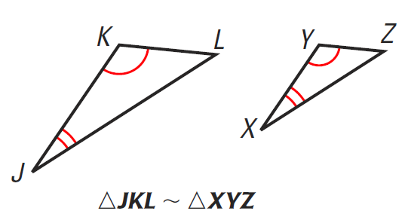
∡-∡(AA) ~ Postulate
If two ∡s of one ∆ are ≅ to two ∡s of another ∆, then the two ∆s are ~.

Slide 4
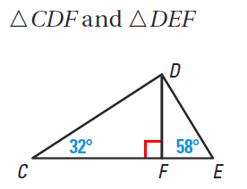
Show ∆s are ~
∡CDF = 58º
∡DFE = 90º
∆CDF~∆DEF
(∆ Sum Thm)
(Linear Pair)
(AA)

Slide 5
A woman that is 5’4” casts a shadow that is 40” long. A child standing next to her is 58” tall. How long is the child’s shadow?

