Slide 1
8.1 Find ∡ Measures in Polygons
Mrs. Vazquez
Geometry

Slide 2
g.mg.1
Essential Question:
How do I find ∡ measures with polygons?
Objective:
Students will be able to find ∡ measures in polygons.

Slide 3
Polygon interior ∡s theorem
The sum of the measures of the interior ∡s of a convex polygon is (n-2)∙180.
Find the sum of the measures of interior ∡s of a convex 11-gon.
The sum of interior ∡s of a polygon is 1440º. Classify the polygon by the number of its sides.

Slide 4
Find x
A pentagon has interior angles that measure 93º, 156º, & 85º. The base ∡s of the polygon are ≅. Find the measure of each ∡.

Slide 5
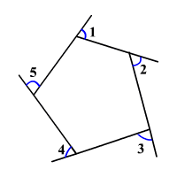
Polygon exterior ∡s theorem
The sum of the measures of the exterior ∡s of a convex polygon is 360.
A convex hexagon has exterior ∡s of 34º, 49º, 58º, 67º, & 75º. What is the measure of the 6th exterior ∡?

