Slide 1
8.4 Properties of Rhombuses, Rectangles, and Squares
Mrs. Vazquez
Geometry

Slide 2
g-co.3.11, g-srt.2.5, g-gpe.2.7
Essential Question:
How do I use properties of rhombuses, rectangles, & squares?
Objective:
Students will be able to solve for parts of rhombuses, rectangles, & squares using their properties.

Slide 3
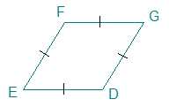
Rhombus corollary
A quadrilateral is a rhombus iff it has four ≅ sides.

Slide 4
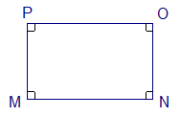
Rectangle corollary
A quadrilateral is a rectangle iff it has four ∟s.

Slide 5
square corollary
A quadrilateral is a square iff it is a rhombus & a rectangle.

Slide 6
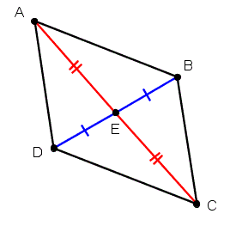
thm 8.11
A parallelogram is a rhombus iff its diagonals are ⊥.

Slide 7
thm 8.12
A parallelogram is a rhombus iff its diagonals bisect a pair of opposite ∡s.

Slide 8
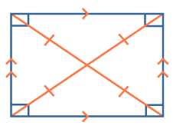
thm 8.13
A parallelogram is a rectangle iff its diagonals are ≅.

