Slide 1
8.5 Use Properties of Trapezoids and Kites
Mrs. Vazquez
Geometry

Slide 2
g-srt.2.5, g-gpe.2.4
Essential Question:
How do I use properties of trapezoids & kites?
Objective:
Students will be able to solve for parts of trapezoids & kites using their properties.

Slide 3
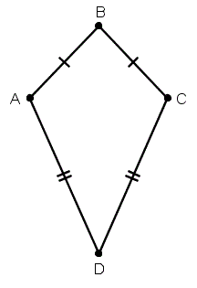
Trapezoid: quadrilateral with one pair of || sides
Kite: quadrilateral that has two pairs of consecutive ≅ sides

Slide 4
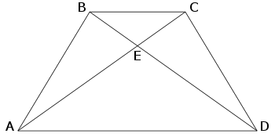
Thm 8.14 (8.15 = converse)
If a trapezoid is isosceles, then each pair of base ∡s is ≅.

Slide 5
Thm 8.16
If a trapezoid is isosceles iff its diagonals are ≅.

Slide 6
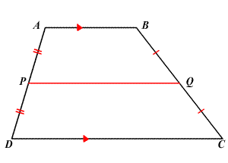
midsegment theorem for trapezoids
The midsegment of a trapezoid is || to each base & its length is ½ the sum of the lengths of the bases.

Slide 7
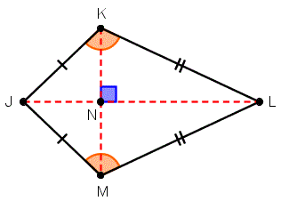
thm 8.18
If a quadrilateral is a kite, then its diagonals are ⊥.

Slide 8
thm 8.19
If a quadrilateral is a kite, then exactly one pair of opposite ∡s are ≅.

