Slide 1
9.1 Translate Figures and Use Vectors
Mrs. vazquez
Geometry

Slide 2
g.co.4, g.co.5
Essential Question:
How can vectors be used to translate figures?
Objective:
Students will be able to use a vector to translate a figure on a coordinate plane.

Slide 3
Translate
Write a rule to go from A to A’ if A is moved 4 units left & 1 unit up.
Write a rule for the A’ to return to A.
(x - 4, y + 1)
(x + 4, y - 1)

Slide 4
Vectors
vector: a quantity that has both direction & magnitude (size)
initial point: starting point of a vector
terminal point: the end point
(horizontal/vertical) component:
that amount by which it is moved in a direction

Slide 5
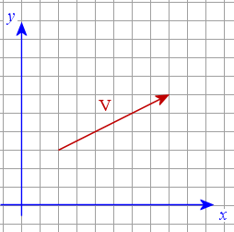
vectors
component form:
combines horizontal & vertical components
V <6,3>

Slide 6
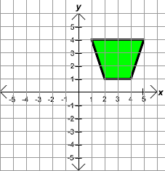
translate
∆LMN. Translate using <-2,6>
L (2,2)
M (5,3)
N (9,1)
Translate using <-2, -3>
L’ (0, 8)
M’ (3, 9)
N’ (7, 7)

