Slide 1
9.2 Use Properties of Matrices
Mrs. Vazquez
Geometry

Slide 2
N.VM.8
Essential Question:
How can matrices be used to translate figures?
Objective:
Students will be able to use a matrix to translate a figure on a coordinate plane.

Slide 3
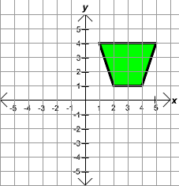
Represent ordered on a matrix
Points
x
y

Slide 4
Represent in a matrix
∆ABC
A (3,5)
B (6,7)
C (7,3)
A | B | C
3 | 6 | 7
5 | 7 | 3

Slide 5
Add/Subtract
6 8 5 1 - 7 0
4 9 -1 4 -2 3
1 -4 2 3
3 -5 7 8
7 | 1 | 5
8 | 7 | 2
-1 | -7
-4 | -13

Slide 6
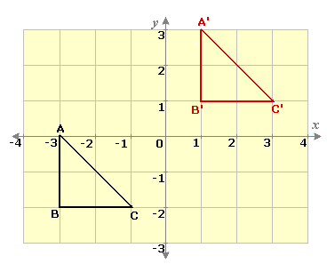
translate in a matrix
Ordered Pairs + Translation Matrix
= Translated Ordered Pairs
A | B | C
-3 | -3 | -1
0 | -2 | -2
4 | 4 | 4
3 | 3 | 3
A’ | B’ | C’
1 | 1 | 3
3 | 1 | 1

Slide 7
Multiply
The first matrix represents the amount of rows. The second matrix represents the amount of columns.
Multiply Corresponding Rows & Columns & Find the Sum
First Row x First Column 1(2) + 0(-1)
First Row x Second Column 1(-3) + 0(8)
Second Row x First Column 4(2) + 5(8)
Second Row x Second Column 4(-3) + 5(8)
1 0 2 -3
4 5 -1 8
a b
c d

Slide 8
Solve
Two softball teams submit equipment lists for the season. A bat costs $25, a ball costs $4, and uniforms cost $35. Find the total cost of equipment using a matrix.
Women’s Men’s
Bats 13 15
balls 42 45
Uniforms 16 18

