Slide 1
9.3 Perform Reflections
Mrs. vazquez
Geometry

Slide 2
g.co.5
Essential Question:
How can we use Algebra to reflect figures on a coordinate plane?
Objective:
Students will be able to reflect images on any given line.

Slide 3
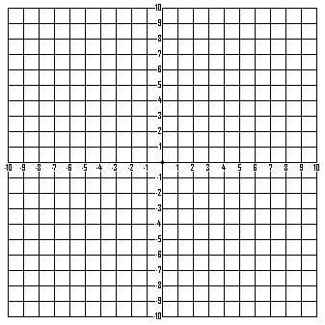
Reflect ∆ABC
A (1,3)
B (5,2)
C (2,1)
Over the line:
y = 4
x = -3

Slide 4
Reflect Algebraically
If A(x, y) is reflected:
over the x-axis, then A’(x, -y)
over the y-axis, then A’(-x, y)
over line y = x, then A’(y, x)
over line y = -x, then A’ (-y, -x)
A(1,3) B(4,4) C(3,1)
Reflect ∆ABC over y = x
Reflect ∆ABC over y = -x

Slide 5
Reflect using matrices
Reflect over x-axis.
*Multiply using matrix
1 0
0 -1
Reflect over y-axis.
*Multiply using matrix
-1 0
0 1

Slide 6
l(-3,3) m(1,2) n(-2,1)
Reflect ∆LMN over x-axis.
Reflect ∆LMN over y-axis.

