Slide 1
9.5 Apply Compositions of Transformations
Mrs. vazquez
Geometry

Slide 2
g.co.2, g.co.5
Essential Question:
What properties can there be when two transformations are combined?
Objective:
Students will be able to analyze properties of composite transformations.

Slide 3
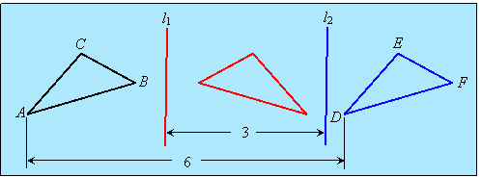
Reflections in || Lines Thm
If l₁ and l₂ are ||, then a reflection over l₁ followed by a reflections over l₂ is the same as a translation.
*The distance between
A and D are twice the distance between l₁ and l₂.

Slide 4
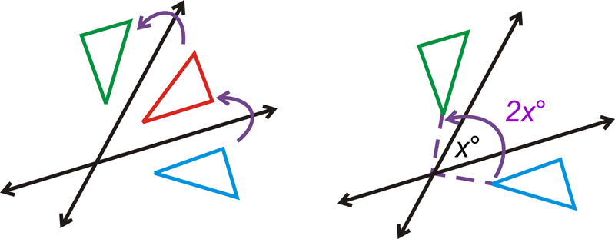
Reflections in || Lines Thm
If a reflection over one intersecting line is followed by another reflection over the other intersecting line, then it’s the same as a rotation.
*The m∡ of rotation is twice the m∡ of acute/∟ formed by the intersecting lines.

