Slide 1
9.6 Identify Symmetry
Mrs. vazquez
Geometry

Slide 2
g.co.3
Essential Question:
What type of symmetry does the figure have?
Objective:
Students will be able to identify line and rotational symmetry of a figure.

Slide 3
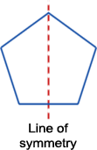
line symmetry
A figure has line symmetry if it can be mapped onto itself by a reflection in a line.
A figure may have 1+ lines of symmetry.

Slide 4
lines of symmetry

Slide 5
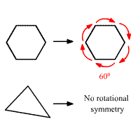
rotational symmetry
A figure has rotational symmetry if it can be mapped onto itself by a 180º or less rotation.

Slide 6
Does it have rotational symmetry?

