Slide 1
2.4 Use Postulates and Diagrams
Mrs. vazquez
Geometry

Slide 2
g-co.1.1 , 3.9-11
Essential Question:
How will I use postulates?
Objective:
Students will be able to use postulates involving points, lines, and planes.

Slide 3
points, lines, & planes Postulates
Through any two points there exists exactly one line.
A line contains at least two points.
If two lines intersect, then their intersection is exactly one point.
Through any three noncollinear points, there exists exactly one plane.
A plane contains at least three noncollinear points.
If two points lie in a plane, then the line containing them lies in the plane.
If two planes intersect, then their intersection is a line.

Slide 4
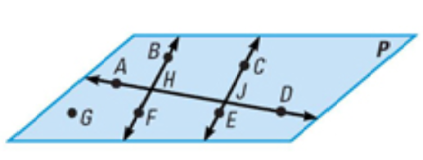
You can assume info about size or measure iff it’s marked.
You can assume:
All points are coplanar
∡AHB & ∡BHD are a linear pair
∡AHF and ∡BHD are vertical ∡s
A, H, J, & D are collinear
AD & BF intersect at H
You can’t assume:
G,F, & E are collinear
BF and CE are ||
∡BHA ≅ ∡CJA
AD ⊥ BF

