Slide 1
2.5 Reason Using Properties from Algebra
Mrs. vazquez
Geometry

Slide 2
a-rei.1; g-co.9-11
Essential Question:
How do I use the properties in a proof?
Objective:
Students will be able to use algebraic properties in logical arguments.

Slide 3
Solve & reason
4x + 9 = -3x + 2
7x + 9 = 2
7x = -7
x = -1
Reason:
+3x
+3x
+ Prop. of =
-9
-9
- Prop. of =
÷ Prop. of =
7
7

Slide 4
Solve & Reason
You target heart rate (r) while you exercise at 70% is determined by the formula r = 0.7(220 - a), where a represents your age. Solve for a.
Solve Reason

Slide 5
Name the property
If m∡6 = m∡7,
then m∡7 = m∡6.
m∡W = m∡W
reflexive property
symmetric property
If JK = KL and KL = 12,
then JK = 12.
transitive property

Slide 6
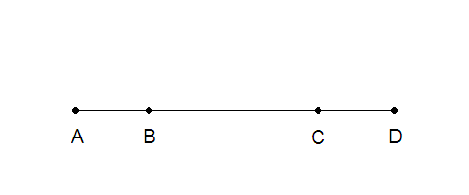
Show AC = BD
AB = CD given
Given AB ≅ CD
AC = AB + BC Segment Add. Post.
BD = CD + BC Segment Add. Post.
BD = AB + BC Transitive Prop
BD = AC Symmetric Prop

