Slide 1
2.6 Prove Statements about Segments and ∡s
Mrs. vazquez
Geometry

Slide 2
g-c0.9-11
Essential Question:
How will I write a proof using geometric theorems?
Objective:
Students will be able to write proofs using geometric theorems.

Slide 3
Proof
a logical argument that shows a statement is true.

Slide 4
Theorem
Theorem 2.1 : ≅ of Segments
Reflexive:
For any segment AB, AB ≅ AB
Symmetric:
If AB≅CD, then CD≅AB
Transitive:
If AB≅CD & CD≅EF, then AB≅EF
Theorem 2.2 : ≅ of ∡s
Reflexive:
For any ∡A, ∡A≅∡A
Symmetric:
If ∡A≅∡B, then ∡B≅∡A
Transitive:
If ∡A≅∡B & ∡B≅∡C, then
∡A≅∡C

Slide 5
Prove AB=BC
A B C
Given AC = AB + AB
Prove AB = BC
AC = AB + AB given
AB = BC
AC = AB + BC Segment Add.Post
AB + AB = AB + BC Transitive Prop
Subtraction Prop. =

Slide 6
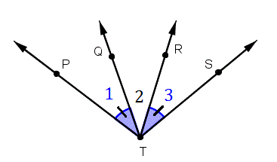
m∡1 = m∡3 given
m∡PTR = m∡STQ
m∡PTR = m∡1 + m∡2 ∡ Add. Post.
Given m∡1 = m∡3
Prove m∡PTR = m∡STQ
m∡STQ = m∡3 + m∡2 ∡ Add. Post.
m∡STQ = m∡1 + m∡2 Transitive Prop.
m∡STQ = m∡PTR Transitive Prop.
Symmetric Prop.

Slide 7
Walking down the hallway at the mall, you notice the music store is halfway between the food court & the shoe store. The shoe store is halfway between the music store & the book store. Prove that the distance between the entrances of the food court & music store is the same as the distance between the entrances of the shoe store & book store.

