Slide 1
2.7 Prove ∡ Pair Relationships
Mrs. vazquez
Geometry

Slide 2
g-co.3.9
Essential Question:
How will I prove special ∡s are ≅?
Objective:
Students will be able to use properties of special pairs of ∡s.

Slide 3
Theorems
2.3 : All ∟s are ≅.
2.4 : If two ∡s are supplementary to the same ∡ (or to ≅ ∡s), then they are ≅.
2.5 : If two ∡s are complementary to the same ∡ (or to ≅ ∡s), then they are ≅.

Slide 4
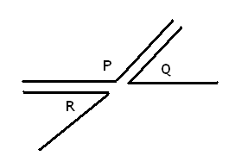
theorem 2.4
If ∡R and ∡P are supplementary, and ∡Q and ∡P are supplementary, then ∡R≅∡Q.

Slide 5
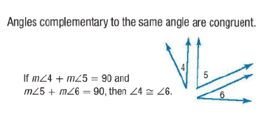
theorem 2.5

Slide 6
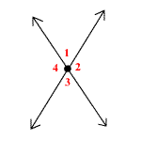
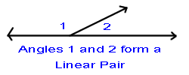
Postulate 12 (Linear Pair Postulate)
If two ∡s form a linear pair, then they are supplementary.
Theorem 2.6 (Vertical ∡s ≅)
Vertical ∡s are ≅.

